Slide 1
Today is Madron Feast.

Slide 2
Nowadays there are less events than before: a church service and the hunt.

Slide 3
There used to be lots of events in Madron including a special play at the hall.

Slide 4
There also used to be a special tradition called Guise Dancing

Slide 5
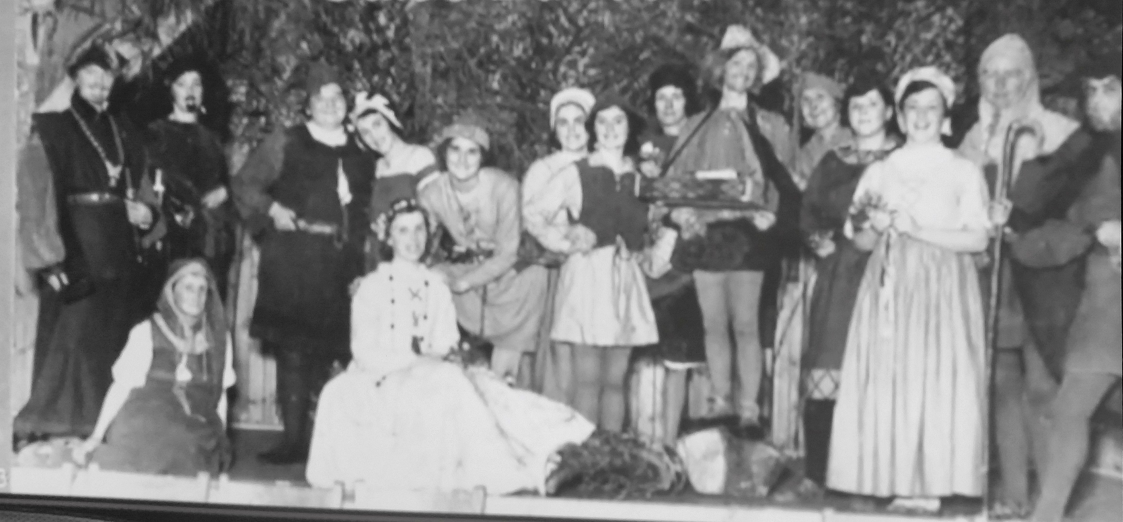

Slide 6
This was an old Cornish Tradition done at special times during the Winter.

Slide 7
People dressed up in special costume to hide who they were.

Slide 8
They used special masks.

Slide 9
They wore special costumes that hid their shape.

Slide 10
There are three kinds of Guise Dancing:
Processions.
Visiting people's houses.
Performing a special play.

Slide 11
Special plays.
These plays sometimes had funny stories.
They sometimes had famous people from the past in them (like St. George).
Sometimes they had scary stories about witches and magic.

Slide 12
Madron Play
In Madron they had a play that was based on the story of St. George and the Turkish Knight.
St George is a Christian Saint.
In this story, he fights an evil knight from Turkey, who kills St. George.
St George is brought back to life by medicine made by a crazy doctor.

Slide 13
Guise Dancing in Madron
So famous that in the 1930's the BBC came to Madron and recorded a special radio programme about it.
This was called “Twelthtide”.

Slide 14
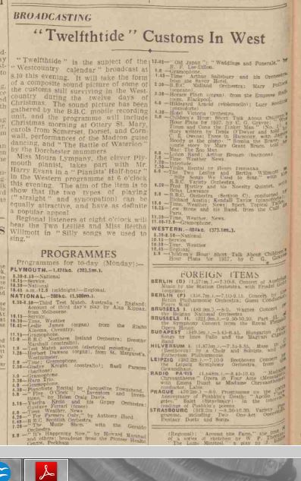

Slide 15
This recording was made by Richard Dimbleby
Richard was the most famous news-man in Britain at the time.

Slide 16
Turkey Rhubarb.
The Madron Guise Dance play had a special dance to go with it.
The dance had a very strange name…
It was called Turkey Rhubarb.

Slide 17
Name
This has nothing to do with Turkeys or Rhubarb.
Turkey Rhubarb is a plant used for medicine.
It makes you go to the toilet.

Slide 18
The Dance
The dance is now used by lots of people in Cornwall when they go “Guise dancing”.

Slide 19
Masks.
Most guise dancers wear masks.
These masks hide your face so people can’t see who you are.
This means you can play tricks on people and beg for money.

Slide 20
Masks
Masks to hide your face.
Animal Masks.
Masked Ball Masks.

Slide 21
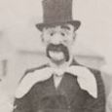

Slide 22
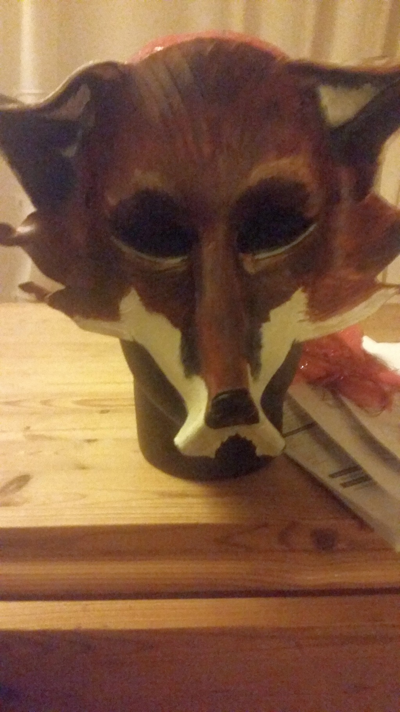

Slide 23
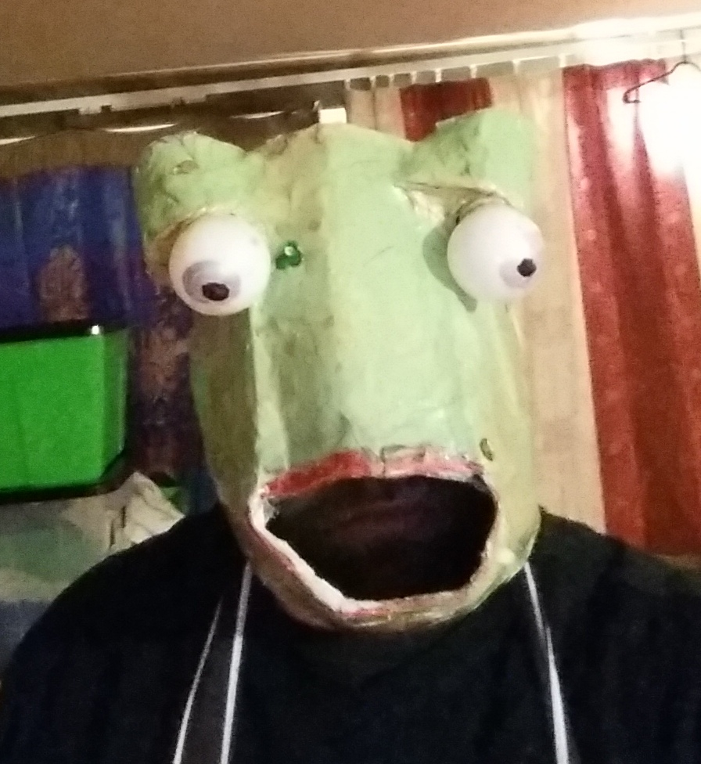

Slide 24
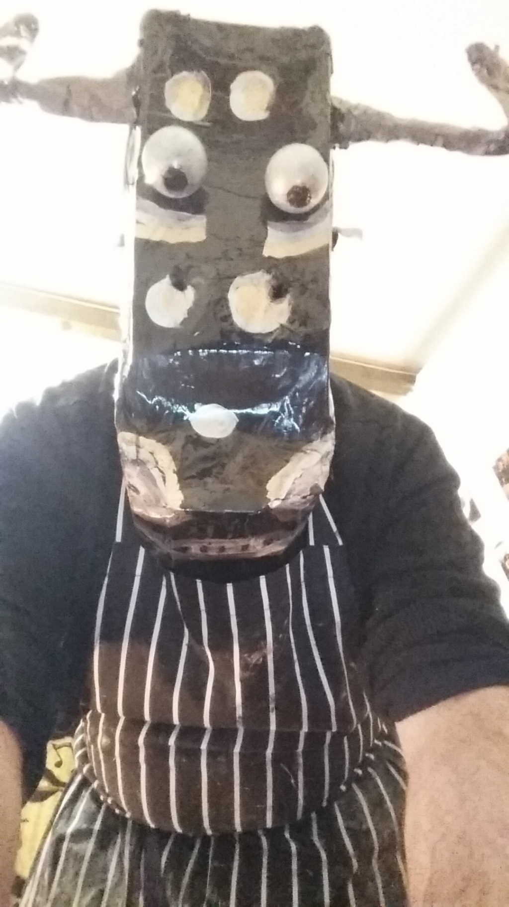

Slide 25
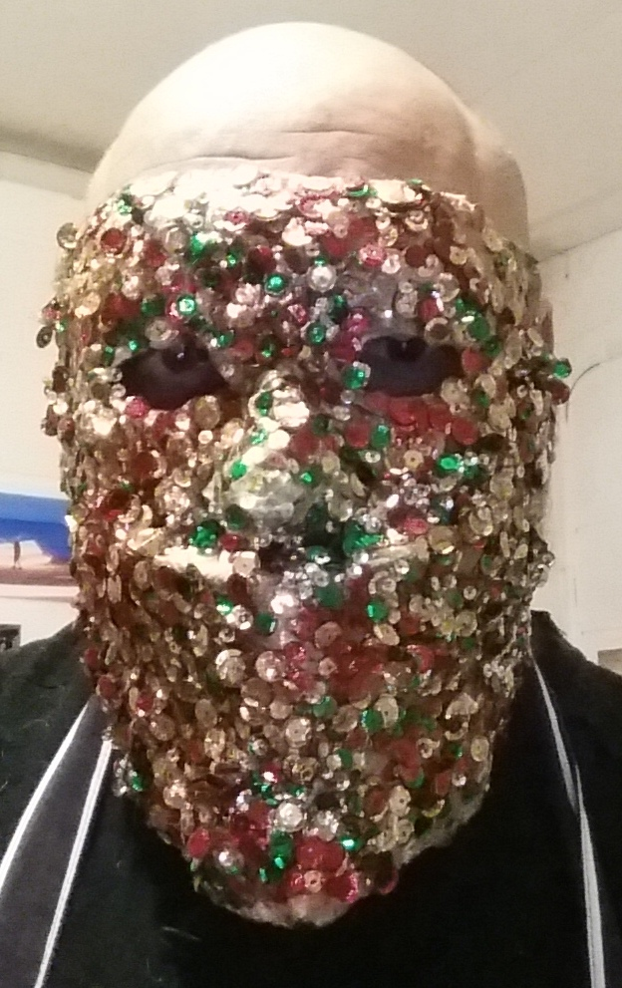

Slide 26
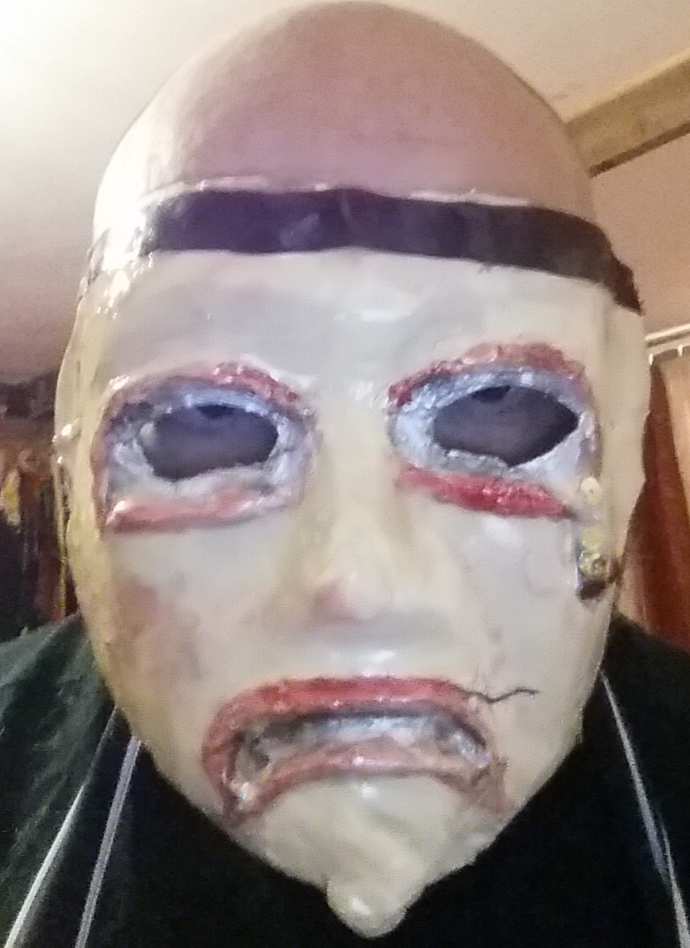

Slide 27
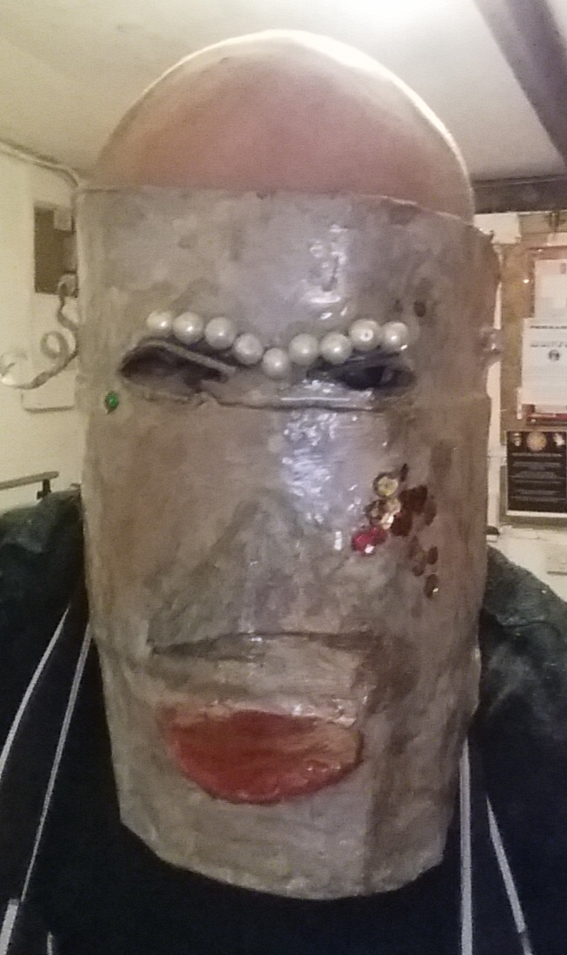

Slide 28
Clothes
Pretend Formal Clothes.
Tatters.
Sometimes dress in costume from other countries.
Sometimes girls dressed like boys.
Sometimes boys dressed like girls.

Slide 29
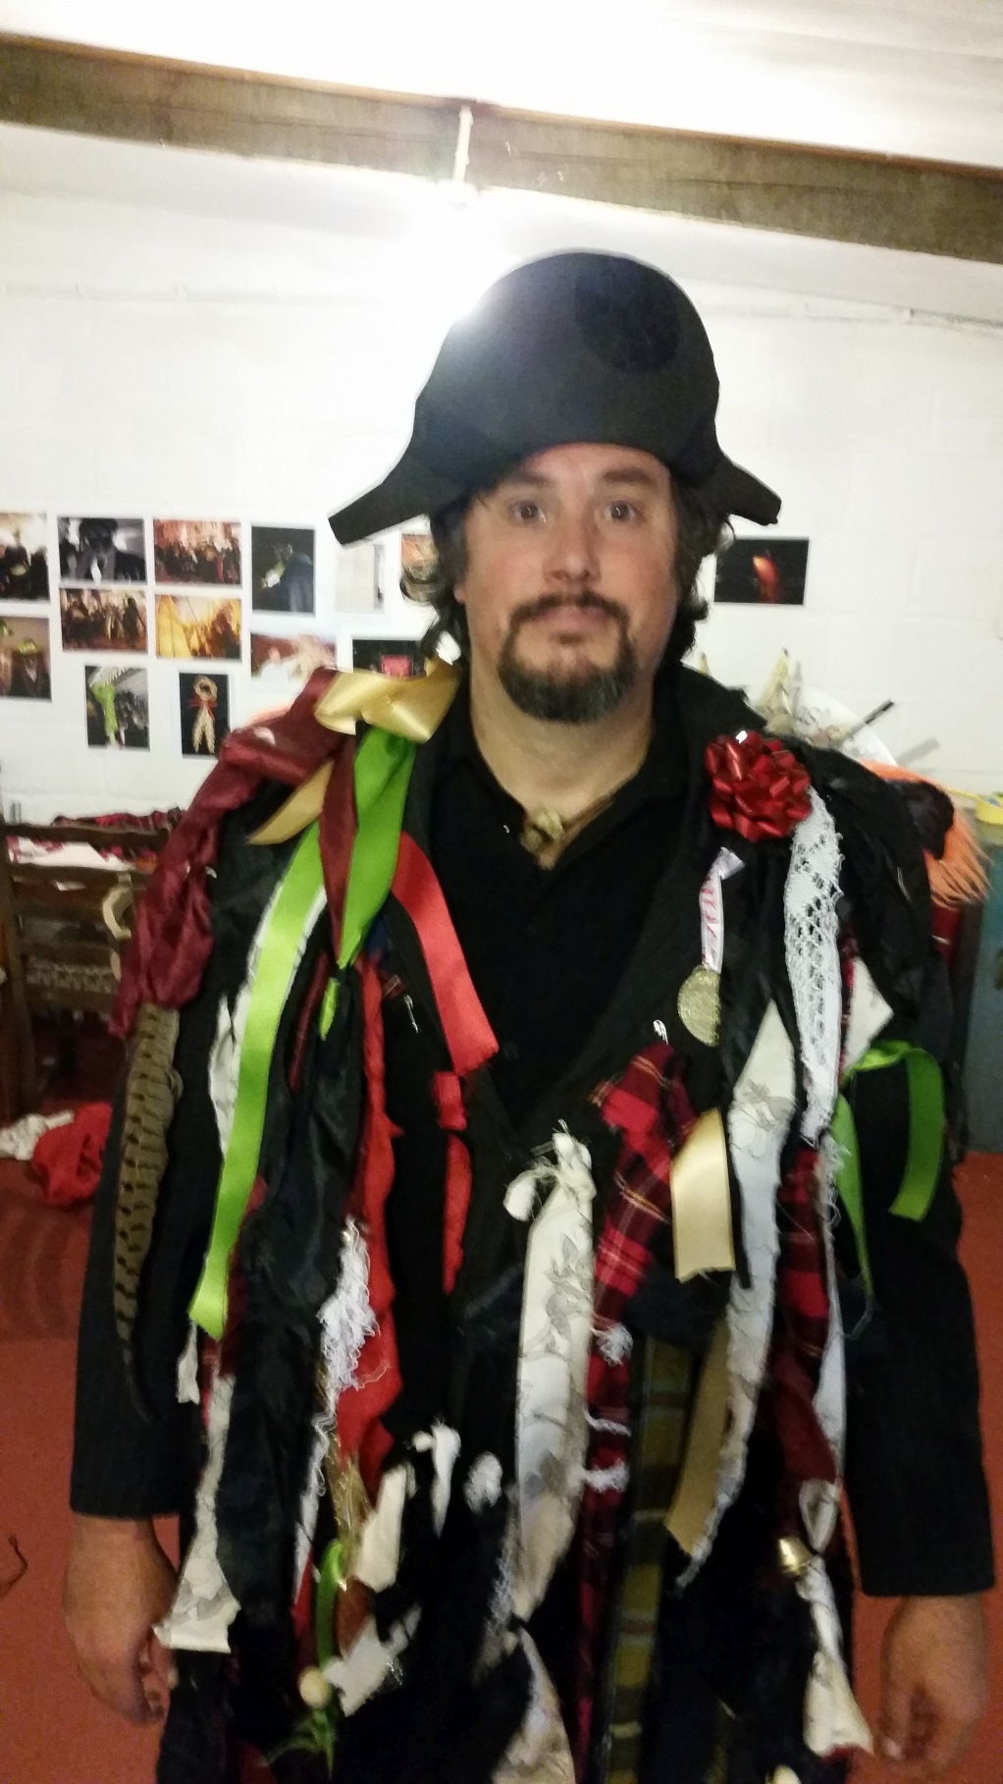

Slide 30
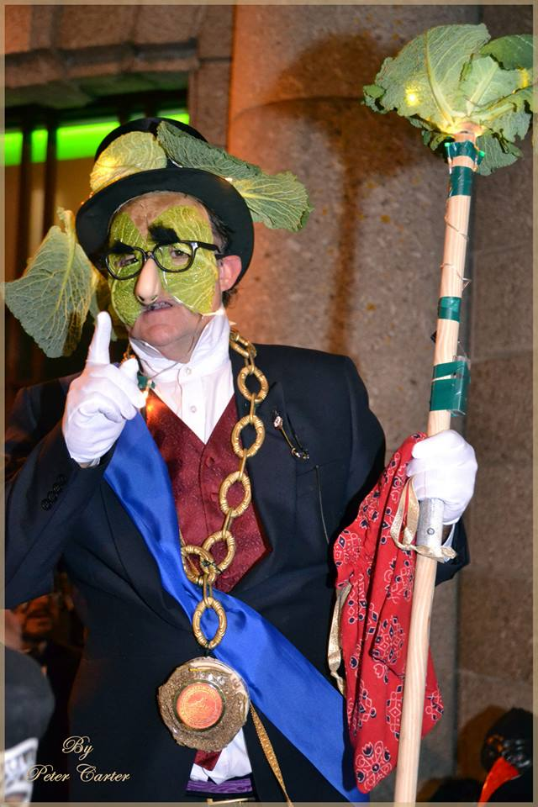

Slide 31
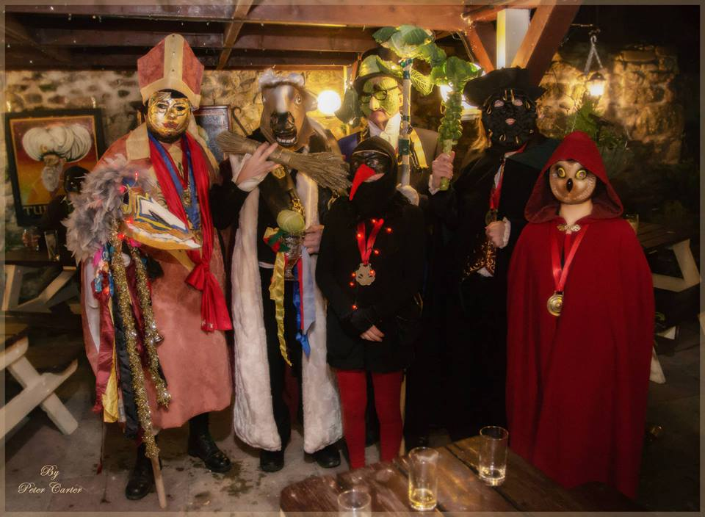

Slide 32
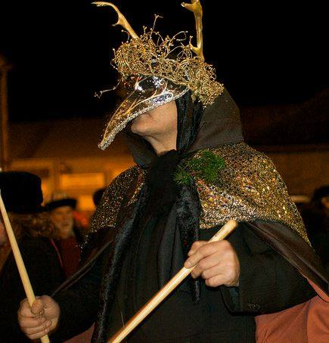

Slide 33
Hats

Slide 34
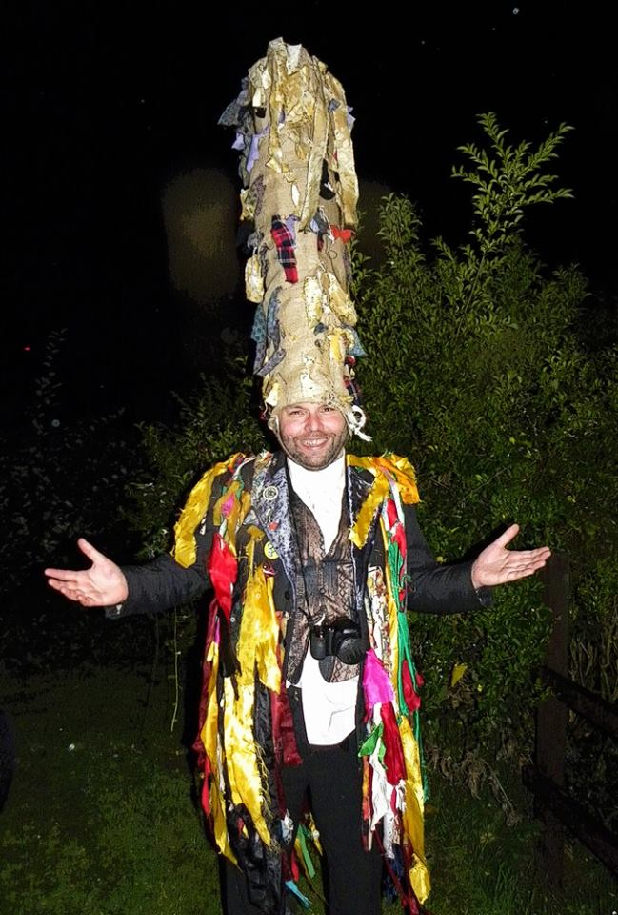

Slide 35
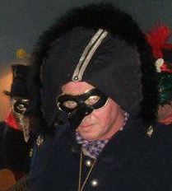

Slide 36
Guise Beasts

Slide 37
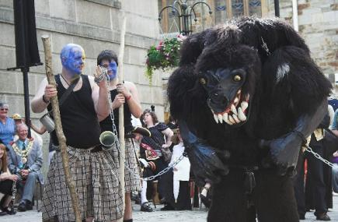

Slide 38
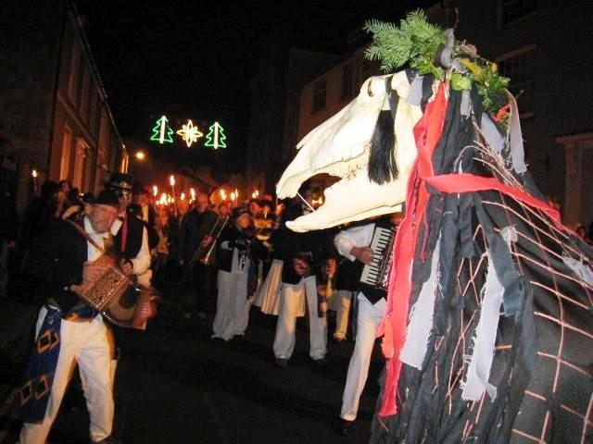

Slide 39
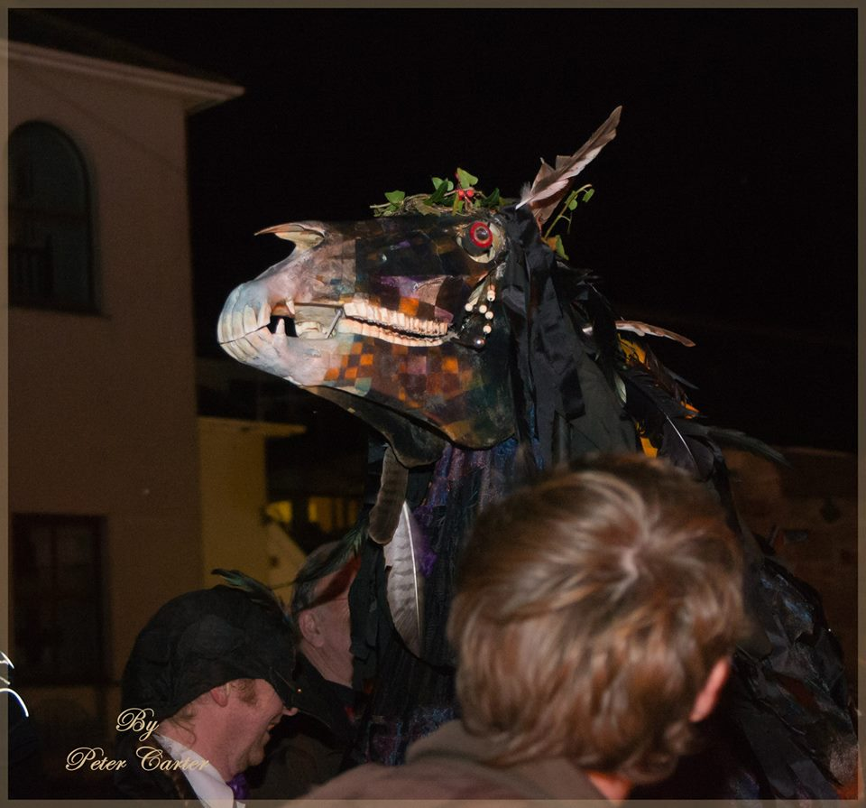

Slide 40
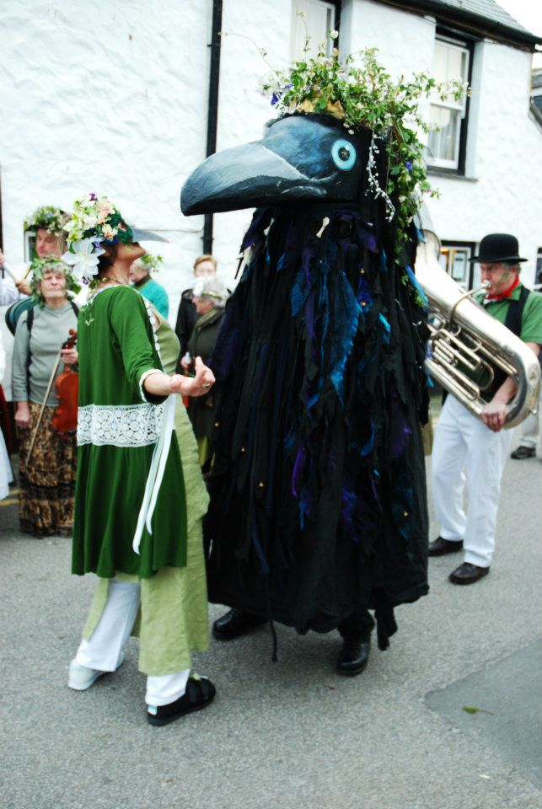

Slide 41
Video of Beast

Slide 42
What we are going to do today
Split into three groups
Group 1 – Make a tatters jacket
Group 2 – Make ¼ Fathom Hats
Group 3 – Make Masks

Slide 43
First group
Cut up cloth and pin them to the jacket.
You will need cloth, scissors and safety pins.
You may want to make a mask afterwards.

Slide 44
Second Group.
Paper.
String.
Stapler.
Scissors.

Slide 45
Group 3
Card.
Scissors.
Something to decorate the masks with.

